Slide 1

Module 4 –Spark Streaming

Slide 2

Spark Streaming
Question No:8
Given below a stream code, based on the snippet try to answer few questions:
1. What has to be the structure of the RDD tweets?
2. What does the function updateMood do?
3. How would you track sessions, maintaining the arbitrary state.
tweets.updateStateByKey(tweet => updateMood(tweet))

Slide 3
Spark Streaming
Question No:8- Solution
What has to be the structure of the RDD tweets?
Must consist of key value pairs with user as key and mood as value
Dinkar Happy
KVS VeryHappy
…
What does the function updateMood do?
Compute the new mood based upon the old mood and tweet
Suppose user Jack (key) tweets “Eating icecream” (value)
Maintaining arbitrary state, track sessions
Maintain per-user mood as state, and update it with his/her tweets
tweets.updateStateByKey(tweet => updateMood(tweet))

Slide 4

SPARK STREAMING
Fault-tolerance
RDDs are remember the sequence of operations that created it from the original fault-tolerant input data
Batches of input data are replicated in memory of multiple worker nodes, therefore fault-tolerant
Data lost due to worker failure, can be recomputed from input data
tweets
RDD
input data replicated
in memory
flatMap
hashTags
RDD
lost partitions recomputed on other workers

Slide 5
BIG DATA
Fault Tolerance
What happens if there is a failure with
Stateless processing
Stateful processing
Stateless
Previous history is not required.
Processing can just be recomputed
Stateful
State from previous batches required for computation.
How much state to retain?

Slide 6
SPARK STREAMING
How much state to retain in Stateful Transformation?- Checkpointing
Sometimes there may be too much data to be stored
For a streaming algorithm, may have to store all the streams
Checkpointing
Stores an RDD
Forgets the lineage
A checkpoint at t+2 will
store the hashTags and tagCounts at t+2
Forget the rest of the lineage
t-1
t
t+1
t+2
t+3
hashTags
tagCounts

Slide 7
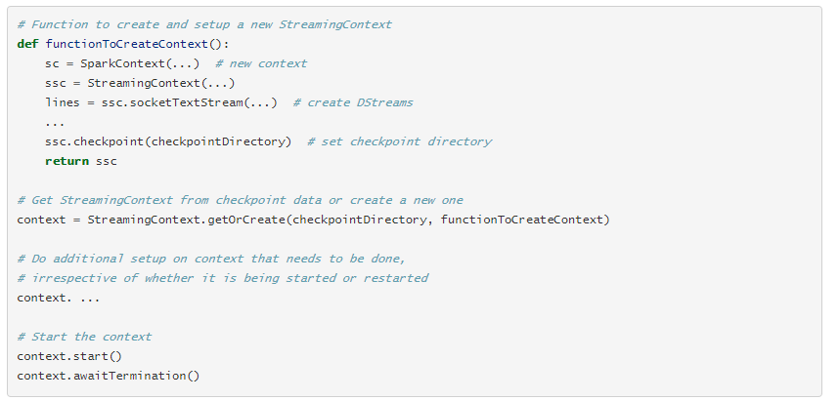
SPARK STREAMING
When and how to enable Checkpoint?

Slide 8
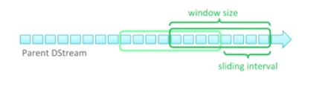
SPARK STREAMING
How to optimize performance for a Dstream?
Val wordcounts= wordstream.reducebykeyand window((x:int,y:int)=> x+y,windowsize,sliding interval)

Slide 9
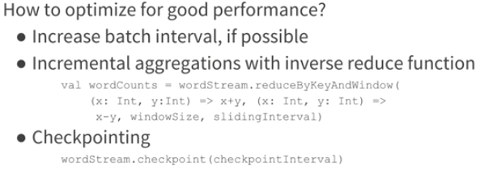
SPARK STREAMING
How to optimize performance for a Dstream?
Scenario: Word count for the last 30 minute

Slide 10
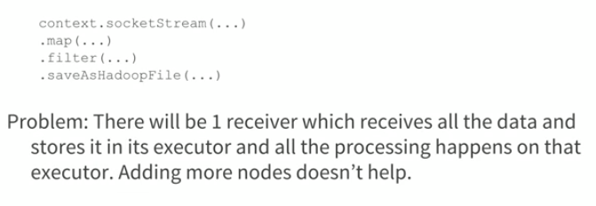
SPARK STREAMING
How to achieve good throughput?

Slide 11
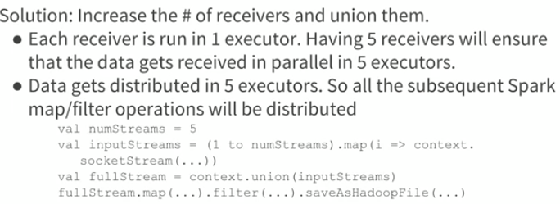
SPARK STREAMING
How to achieve good throughput?

Slide 12
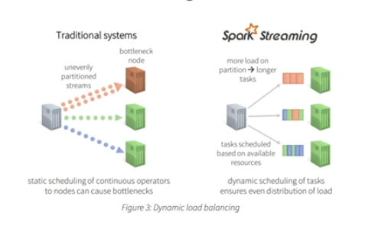
SPARK STREAMING
Key Benefits of Stream Processing-Dynamic Load Balancing

Slide 13
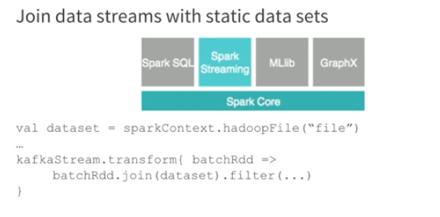
SPARK STREAMING
Combine Batch and Stream Processing

Slide 14
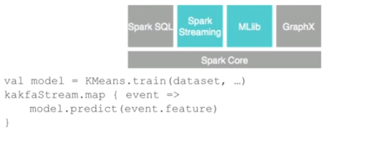
SPARK STREAMING
Combine ML and Stream Processing

Slide 15
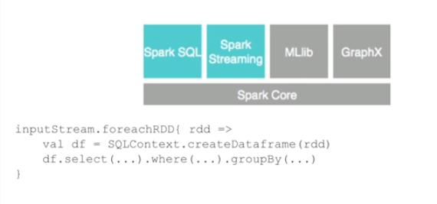
SPARK STREAMING
Combine SQL and Stream Processing

Slide 16
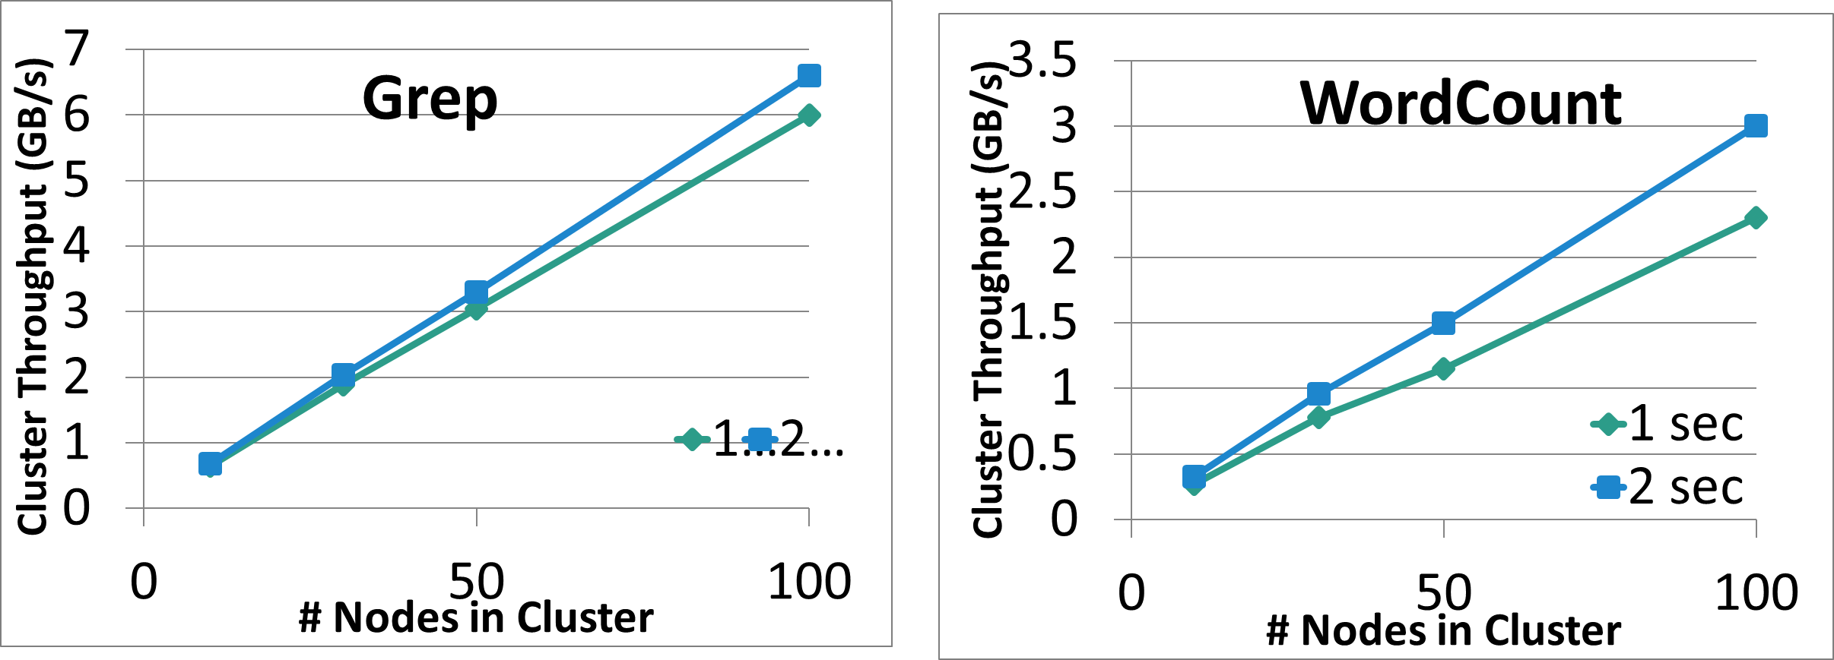
BIG DATA
Performance
Can process 6 GB/sec (60M records/sec) of data on 100 nodes at sub-second latency
Tested with 100 streams of data on 100 EC2 instances with 4 cores each

Slide 17
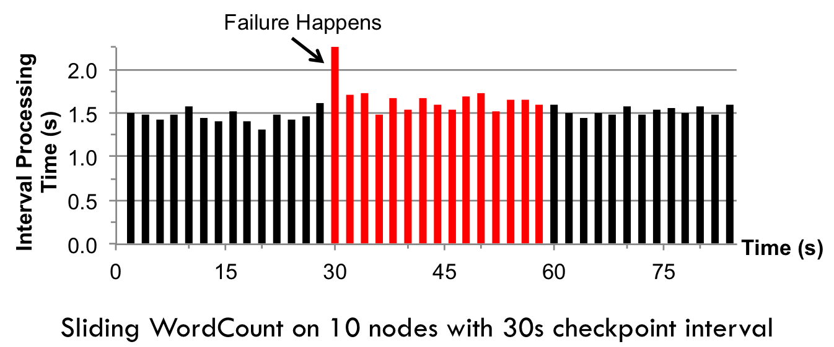
BIG DATA
Fast Fault Recovery
Recovers from faults/stragglers within 1 sec

Slide 18
BIG DATA
Real Applications: Conviva
Real-time monitoring of video metadata
Achieved 1-2 second latency
Millions of video sessions processed
Scales linearly with cluster size

Slide 19
BIG DATA
Real Applications: Mobile Millennium Project
Traffic transit time estimation using online machine learning on GPS observations
Markov chain Monte Carlo simulations on GPS observations
Very CPU intensive, requires dozens of machines for useful computation
Scales linearly with cluster size

Slide 20
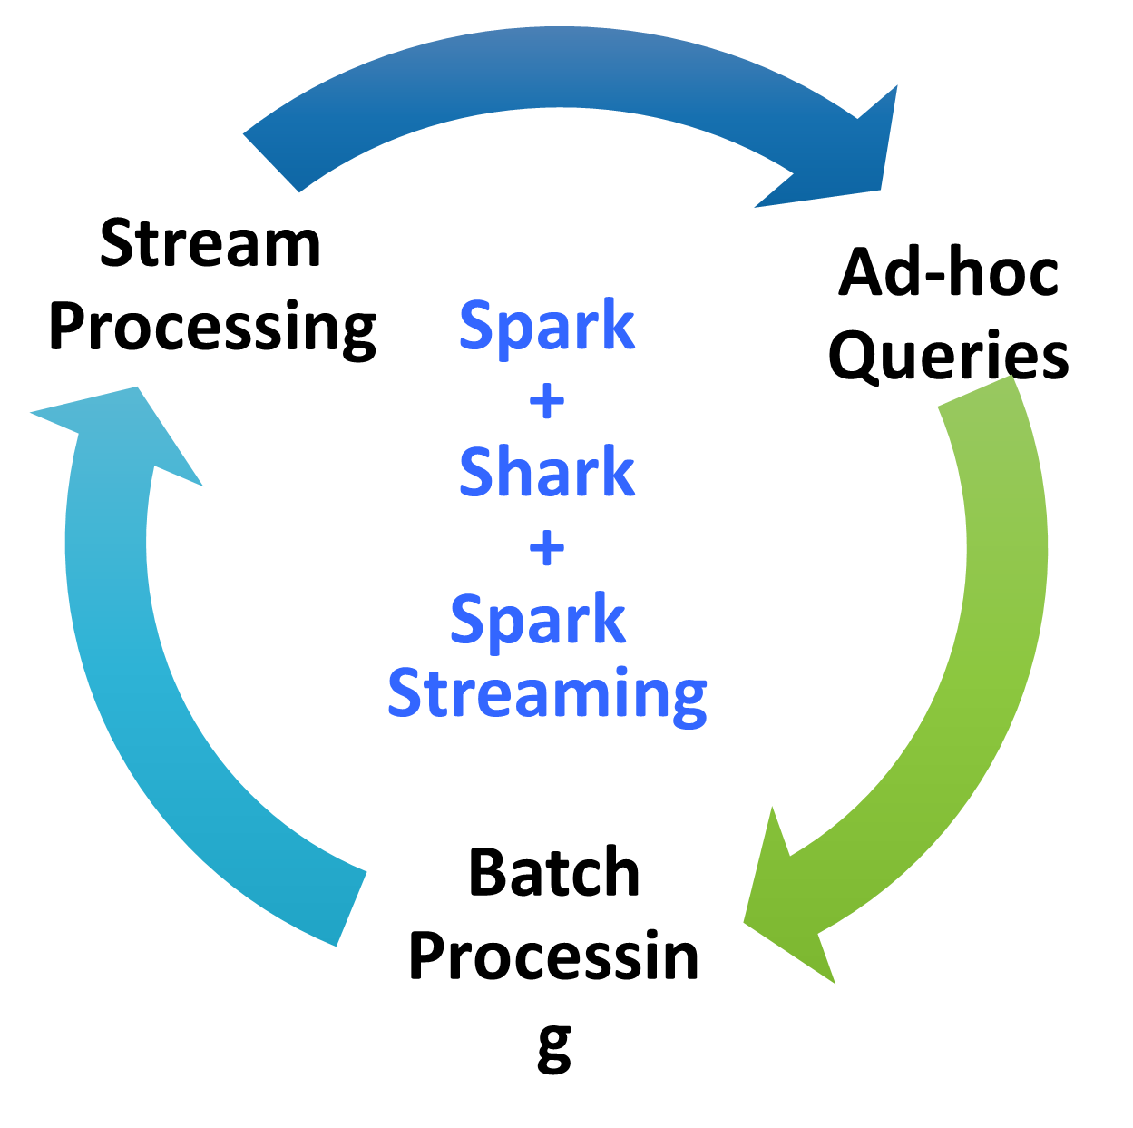
BIG DATA
Vision - one stack to rule them all

Slide 21
BIG DATA
Spark program vs Spark Streaming program
Spark Streaming program on Twitter stream
val tweets = ssc.twitterStream(<Twitter username>, <Twitter password>)
val hashTags = tweets.flatMap (status => getTags(status))
hashTags.saveAsHadoopFiles("hdfs://...")
Spark program on Twitter log file
val tweets = sc.hadoopFile("hdfs://...")
val hashTags = tweets.flatMap (status => getTags(status))
hashTags.saveAsHadoopFile("hdfs://...")

Slide 22
BIG DATA
Vision - one stack to rule them all
Explore data interactively using Spark Shell / PySpark to identify problems
Use same code in Spark stand-alone programs to identify problems in production logs
Use similar code in Spark Streaming to identify problems in live log streams
$ ./spark-shell
scala> val file = sc.hadoopFile(“smallLogs”)
...
scala> val filtered = file.filter(_.contains(“ERROR”))
...
scala> val mapped = file.map(...)
...
object ProcessProductionData {
def main(args: Array[String]) {
val sc = new SparkContext(...)
val file = sc.hadoopFile(“productionLogs”)
val filtered = file.filter(_.contains(“ERROR”))
val mapped = file.map(...)
...
}
}
object ProcessLiveStream {
def main(args: Array[String]) {
val sc = new StreamingContext(...)
val stream = sc.kafkaStream(...)
val filtered = file.filter(_.contains(“ERROR”))
val mapped = file.map(...)
...
}
}

Slide 23
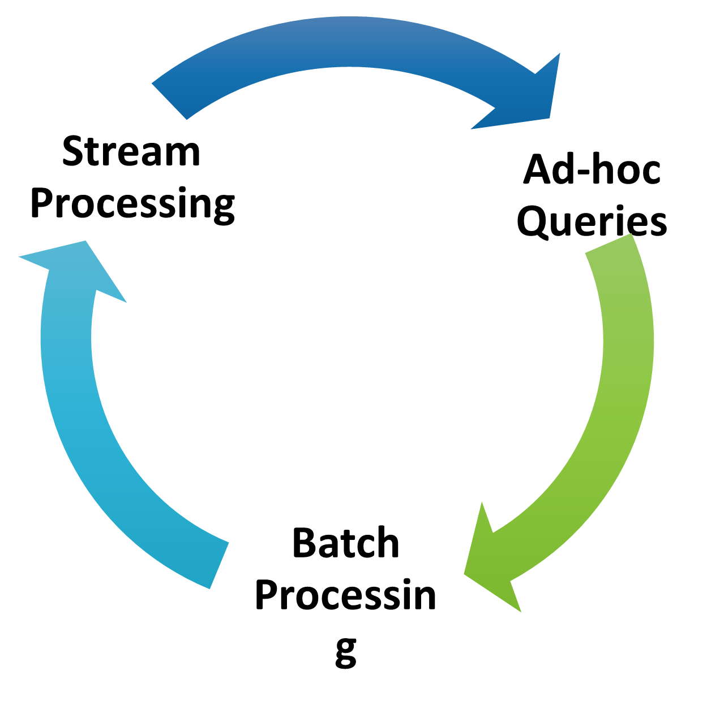
BIG DATA
Vision - one stack to rule them all
Explore data interactively using Spark Shell / PySpark to identify problems
Use same code in Spark stand-alone programs to identify problems in production logs
Use similar code in Spark Streaming to identify problems in live log streams
$ ./spark-shell
scala> val file = sc.hadoopFile(“smallLogs”)
...
scala> val filtered = file.filter(_.contains(“ERROR”))
...
scala> val mapped = file.map(...)
...
object ProcessProductionData {
def main(args: Array[String]) {
val sc = new SparkContext(...)
val file = sc.hadoopFile(“productionLogs”)
val filtered = file.filter(_.contains(“ERROR”))
val mapped = file.map(...)
...
}
}
object ProcessLiveStream {
def main(args: Array[String]) {
val sc = new StreamingContext(...)
val stream = sc.kafkaStream(...)
val filtered = file.filter(_.contains(“ERROR”))
val mapped = file.map(...)
...
}
}

Slide 24
BIG DATA
Alpha Release with Spark 0.7
Integrated with Spark 0.7
Import spark.streaming to get all the functionality
Both Java and Scala API
Give it a spin!
Run locally or in a cluster
Try it out in the hands-on tutorial later today

Slide 25
BIG DATA
Limitations
Streaming Spark processes data in batches
🡪 Near Real Time
Not necessarily acceptable for certain scenarios

Slide 26
THANK YOU

